Slide 1
DO NOW · 10 MIN
Human Population Growth
Friday 18 September 2026
1
What is an ecosystem?
2
What does a producer do?
All the living things in an area, plus their environment.
Makes its own food using light.
3
What does a decomposer do?
4
Write a food chain with three links.
Breaks down dead material and releases the nutrients.
grass → rabbit → fox
What happens to most of the energy at each step of a food chain?
A population of 2 rabbits doubles every year. How many after 5 years?
5
6
About 90% is lost, mostly as heat.
64
Notes:
DO NOW — 10 minutes. Six clicks, one answer each.
This is the whole unit in six questions. Q1 to Q5 are Lessons 1 and 2.
Q6 IS TODAY. 2, 4, 8, 16, 32, 64. Nobody finds it hard, and that is the point — they have just drawn the shape of the entire lesson without noticing.
Take the answer to Q6 and write it on the board. Come back to it on slide 4.
CHANGE THE DATE before you teach.

Slide 2
TODAY · 1 MIN
Learning Objectives
1
2
3
Describe how the human population has changed.
Explain why it grew so quickly.
Describe what that growth does to ecosystems.
You already know what an ecosystem is. Now we add humans.
Notes:
TODAY — 1 minute. Four clicks. Read them and move on.

Slide 3
HOOK · 2 MIN
In 1950 there were 2.6 billion people.
Today, there are 8.2 billion. By what percentage has the population changed?
A
B
C
About 50 years
About 70 years
About 60 years
Notes:
HOOK — 2 minutes. Four clicks: the question, then the three options.
Hands up for each. Tally on the board.
ANSWER: B. The UN puts the tripling at 68 years. Reveal it on the next slide, not here.
MOST CLASSES PICK A OR C, because 5.6 billion extra people sounds like it should take centuries.

Slide 4
I DO · 3 MIN
The population curve
Population growth means the number of individuals going up.
people
1950
2.6 billion
2022
8 billion
Today
8.2 billion
It tripled in 68 years. That bend is called exponential growth.
time
Notes:
I DO — 3 minutes. Six clicks: the axes, the curve, the three figures, the banner.
GO BACK TO DO NOW Q6. Their rabbits went 2, 4, 8, 16, 32, 64. Draw that shape in the air. It is this shape.
THE FLAT PART IS MOST OF HUMAN HISTORY. Thousands of years of very slow change, then a bend within a few lifetimes.
THE ANSWER TO THE HOOK IS B. Point at the tally.
SOURCE if asked: UN World Population Prospects.

Slide 5
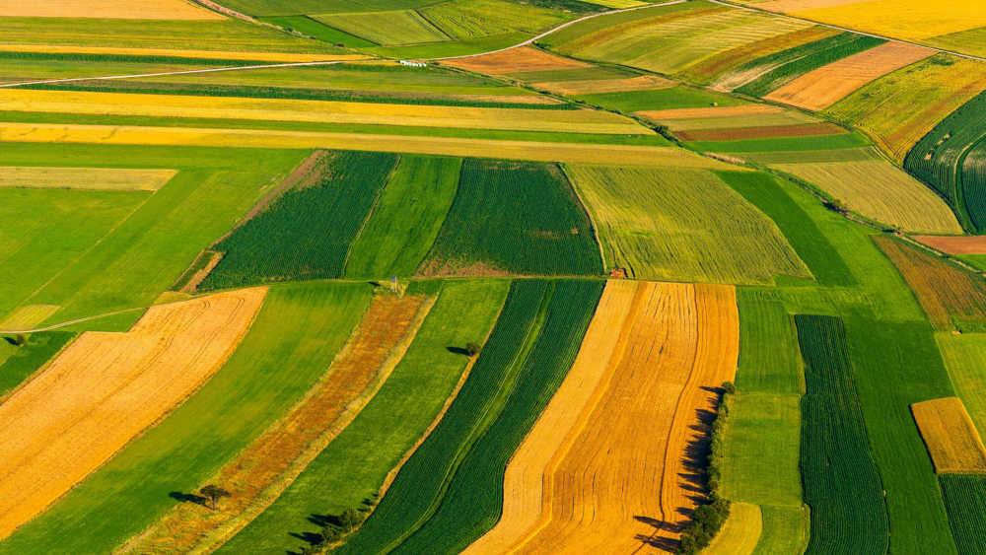
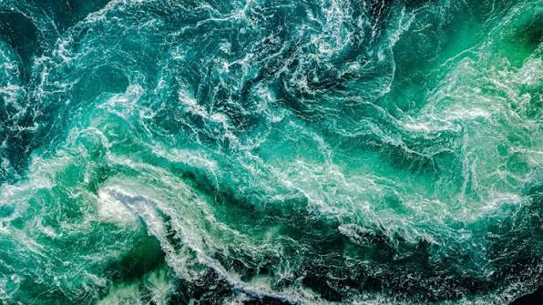
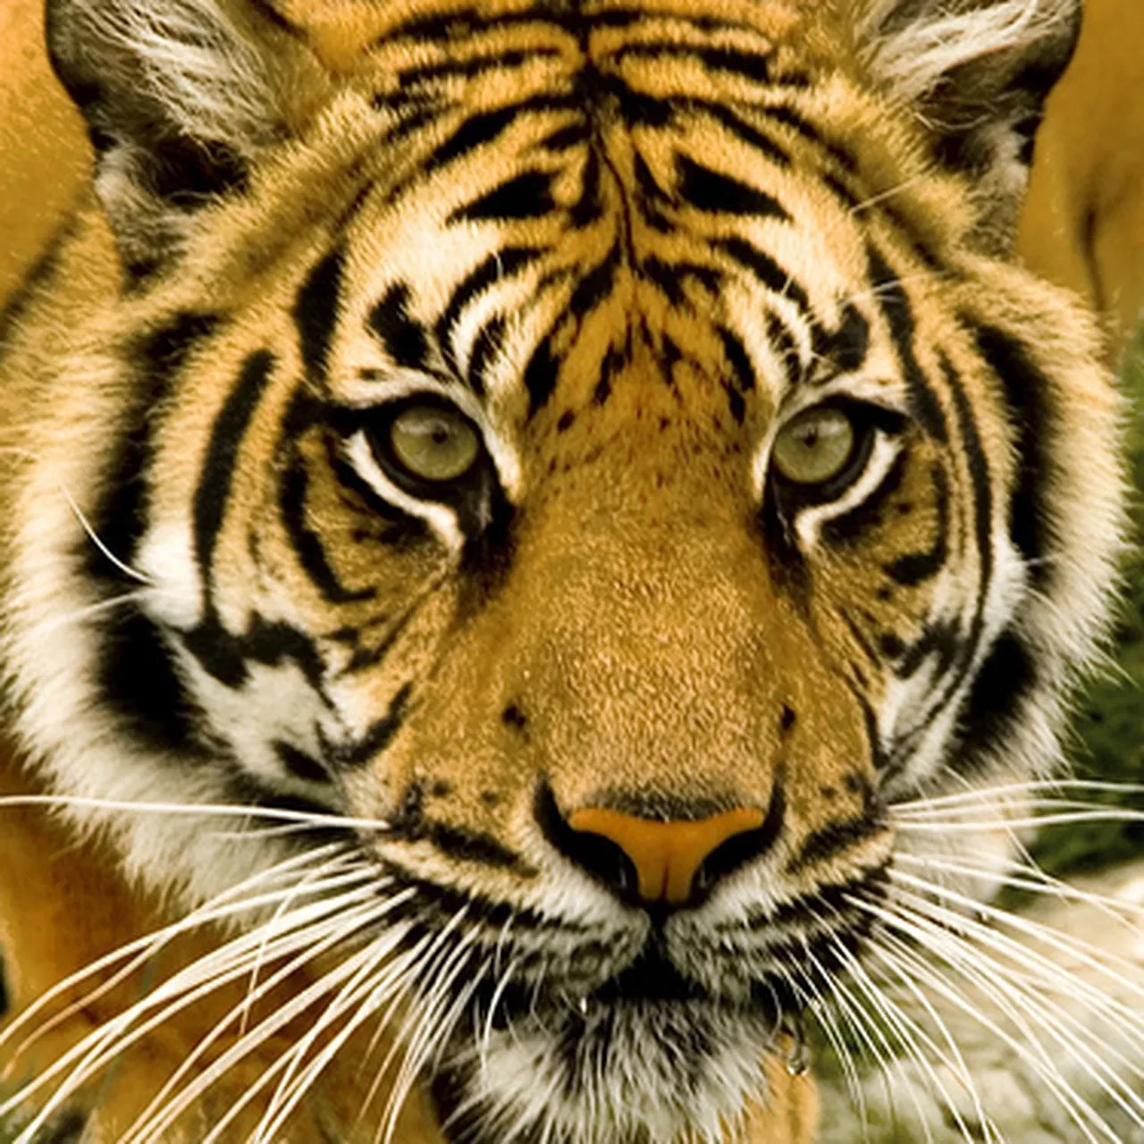
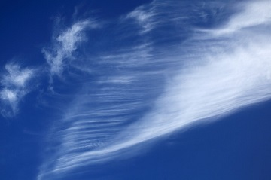
I DO · 3 MIN
What 8 billion people need
Every person needs food, water, energy and space. All of it comes from ecosystems.
Air and climate
Land
Water
Other species
Forest and grassland are cleared to grow food. Habitats disappear.
Rivers are taken for farming and for cities. Less is left for everything else.
Populations of wild animals fall as their space and food are taken.
Burning fuel for energy changes the atmosphere for every ecosystem at once.
We are part of the ecosystem, not visitors to it. Everything we consume comes out of a food chain.
Notes:
I DO — 3 minutes. Five clicks: four impacts, then the banner.
KEEP IT MOVING. One sentence on each. The detail is in the worksheet.
THE BANNER IS THE UNIT LANDING. Lesson 1 said an ecosystem is living things plus their environment. We are living things. Everything on this slide is us being a consumer in a food chain.
DO NOT MAKE THIS A DOOM SLIDE. State it plainly and move on — the plenary ends on the population slowing down.

Slide 6
WE DO · 5 MIN
What should be the correct answer?
Spot the mistake.
The population grew because people started having more babies.
It grew because fewer people died.
The population will keep growing exponentially.
It will likely plateau.
Humans are outside the ecosystem.
We are part of the ecosystem.
The population is growing at the same speed everywhere.
It varies hugely by country.
Notes:
WE DO — 5 minutes. Four clicks, one correction each.
Take answers from the room before each click.
ROW 1 IS THE BIG ONE. Birth rates have FALLEN. The population grew because the death rate fell faster — clean water, food, vaccines, medicine. More people lived, rather than more people being born.
ROW 2: the UN expects a peak of about 10.3 billion in the mid-2080s.
ROW 4: more than half the growth to 2050 is expected in eight countries.

Slide 7
COLD CALL · 6 MIN
1
What does population growth mean?
2
Roughly how many people are alive now?
The number of individuals going up.
About 8 billion.
3
Give one reason fewer people die young now.
4
Name one thing that happens to forests as the population grows.
Clean water · vaccines · medicine · more food
They are cleared to grow food.
5
Are birth rates going up or down?
6
Is the population still growing?
Down, in most of the world.
Yes, but more slowly than before.
Notes:
COLD CALL — 6 minutes. Six clicks.
Name a student, then ask. No hands up. Give thinking time before you take the answer.
If a student cannot answer, take an answer from someone else and then come back to the first student and ask them to repeat it. Everyone stays in the game.
Q3 has several right answers. Take two or three.
Q5 SURPRISES THEM. Birth rates are falling nearly everywhere, and the population is still going up because people live longer.

Slide 8

YOU DO · 14 MIN
Human Population Growth worksheet
Open Google Classroom now.
BRONZE
SILVER
GOLD
Recall
Explain
Reasoning
The numbers, the words, and the shape of the curve.
Why it grew, and what it costs an ecosystem.
Read a graph, argue a case, and judge a claim.
Start anywhere. You do not need to finish every tier.
Notes:
YOU DO — 14 minutes. Four clicks.
The Google Classroom logo is the cue to get devices open. It is faded so it does not compete with the title.
CIRCULATE WITH ONE QUESTION: "which part of the ecosystem does that affect?"
WHERE THEY WILL STALL: the Gold graph question, and the one asking them to judge a claim.
AT 3 MINUTES REMAINING, stop them. The answers are on the next slide.

Slide 9
ANSWERS · 3 MIN
Answers
1
The number of individuals in a population going up.
2
About 8 billion.
3
Producer → consumer → consumer. Energy is lost at every step.
4
The death rate fell: clean water, more food, vaccines and medicine.
5
Birth rates have fallen. People live longer, so the total still rises.
6
Land cleared for farming, so habitats and food chains are lost.
7
Water taken for farms and cities, leaving less for other species.
8
Slow for thousands of years, then a sharp bend upwards.
9
A peak of about 10.3 billion in the mid-2080s.
10
No. Growth is fastest in a small number of countries.
Notes:
ANSWERS — 3 minutes. Five clicks, two answers at a time.
They mark their own in a different colour.
Q5 is the one worth pausing on. Birth rates down, population up — both true at once.
The Gold written answers are not here. Take two or three out loud instead.

Slide 10
PLENARY · 3 MIN
True or false?
The human population grew because birth rates went up.
FALSE
Humans are part of an ecosystem.
TRUE
The population is expected to keep rising for ever.
FALSE
Clearing land for farming destroys habitats.
TRUE
The population is still growing today.
TRUE
That is the unit. Ecosystems, energy, and the one species that changed all of them.
Notes:
PLENARY — 3 minutes. Six clicks.
Hands up, or stand for true. No whiteboards.
Q1 is the We Do again. If it splits the room, it is the first thing to revisit before the test.
Q5 is TRUE and it matters that they leave knowing it. The growth is slowing, not stopped.

